Slide 1

Job Management System Team - PG3
Abhishek Jaiswal - 002191150
Bhawana Agarwal - 002938098
Burhanuddin Jinwala - 002650009
Renjie Meng - 001549859

Slide 2
Contribution
Members | Contribution
Abhishek Jaiswal | DDL&DML for Company, Recruiter, Applicant_skill; Views: user_2022, applicants_with_multiple_profiles, recent_job_postings; Trigger: Update_Company_Applicant; Procedure:create_role, sp_check_applicant, sp_check_company
Bhawana Agarwal | DDL&DML for Job_Posting,Job_Application;Views: applicant_salary, job_applications_total, recent_job_applications, recent_job_postings; Trigger: Login_Trigger; Procedure:sp_check_jobpostingid, sp_check_recruiter, sp_check_skillset, sp_check_usermail
Burhanuddin Jinwala | DDL&DML for User_type,User_account,skill_set,job_skill; Views: edu_by_state, active_job_postings; Trigger: Logoff_Trigger; Procedure: sp_company, sp_insert_applicantprofile, sp_insert_applicantskill, sp_insert_jobskill
Renjie Meng | DDL&DML for Applicant_Profile; Views: highly_actve_applicants, all_job_applications, all_job_postings; Trigger: Update_Job_Application; Procedure: sp_insert_skillset, sp_insertrecruiter, sp_jobapplications, sp_jobpostings

Slide 3
Problem Statement
Job Applications can be a hassle nowadays. With the overwhelming opportunities to apply for so many modern technologies and features available in-market, managing one can be a tedious task. A company can enter many positions in a day. There can be a position that needs to be filled immediately. There may be a case that a given position was filled by someone already working in the company in different departments. Hence, all the applications need to be rejected. Managing this across different locations is a hectic task. For all this, a centralized streamlined solution needs to be established. Databases can be curated to achieve one such solution.

Slide 4
Proposed Solution
In Job Management System, Job Openings data will be classified according to the individual job category and further based on the skills required for the Job. In addition, applicants can keep track of the opening whether the company is still hiring, or the opening is filled.

Slide 5
Concepts Implemented
Stored Procedures
Triggers
Functions
Views
Indexes
Sequences
Grants
Exception Handling

Slide 6
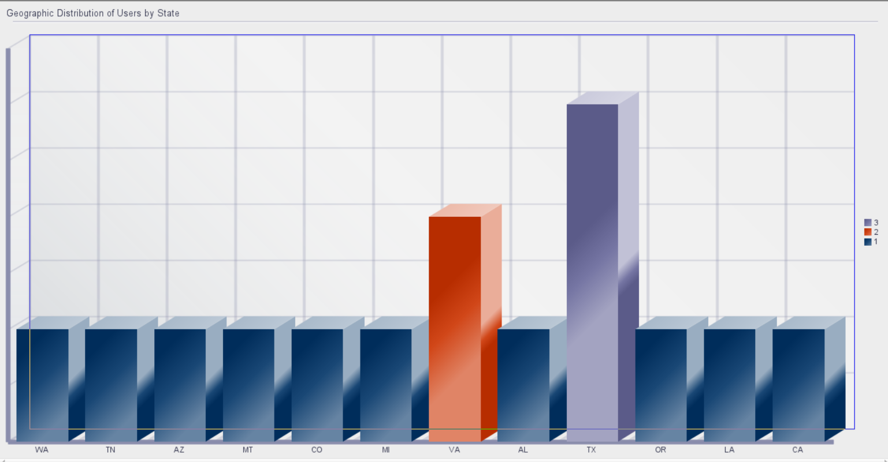
Reports

Slide 7
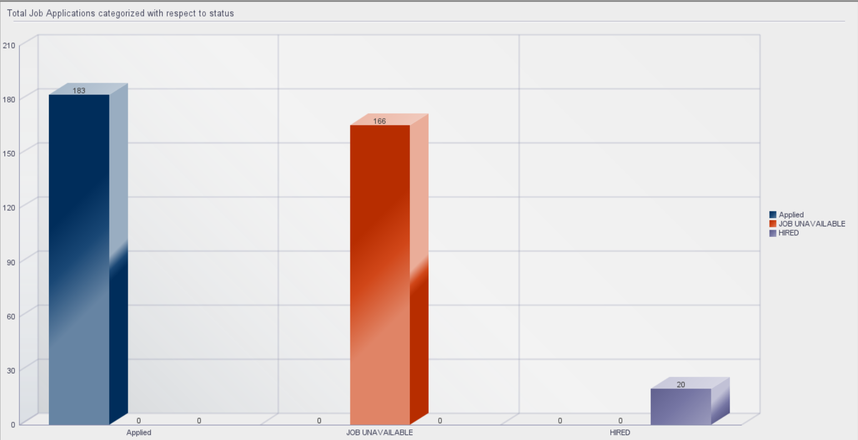

Slide 8
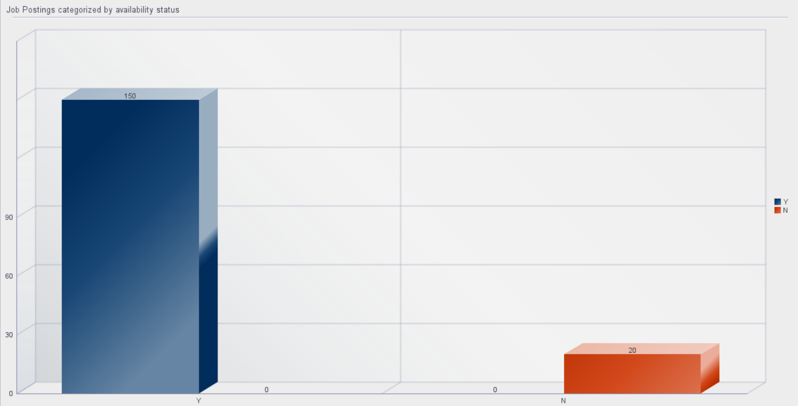

Slide 9
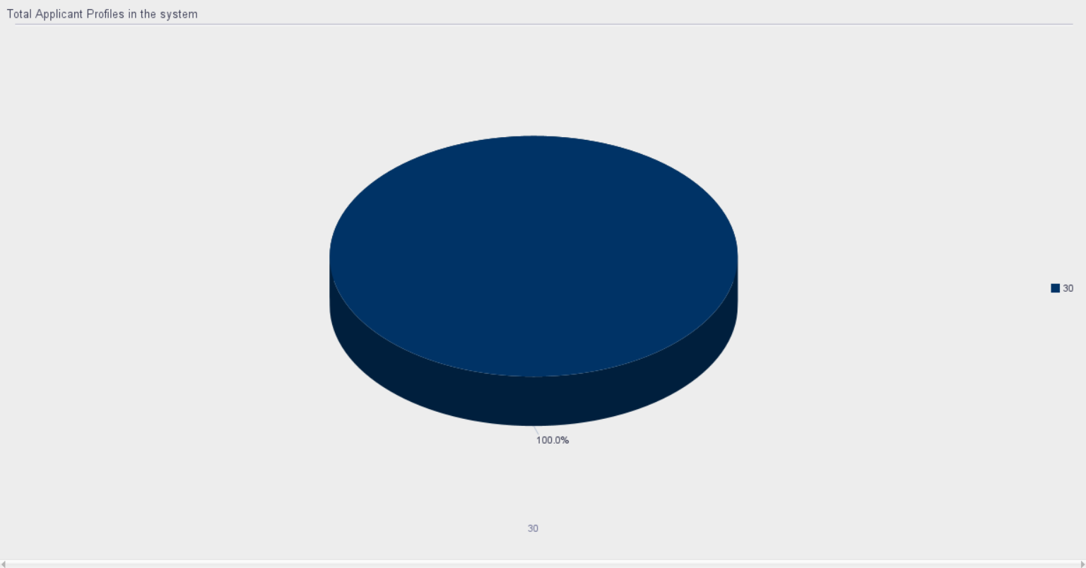

Slide 10
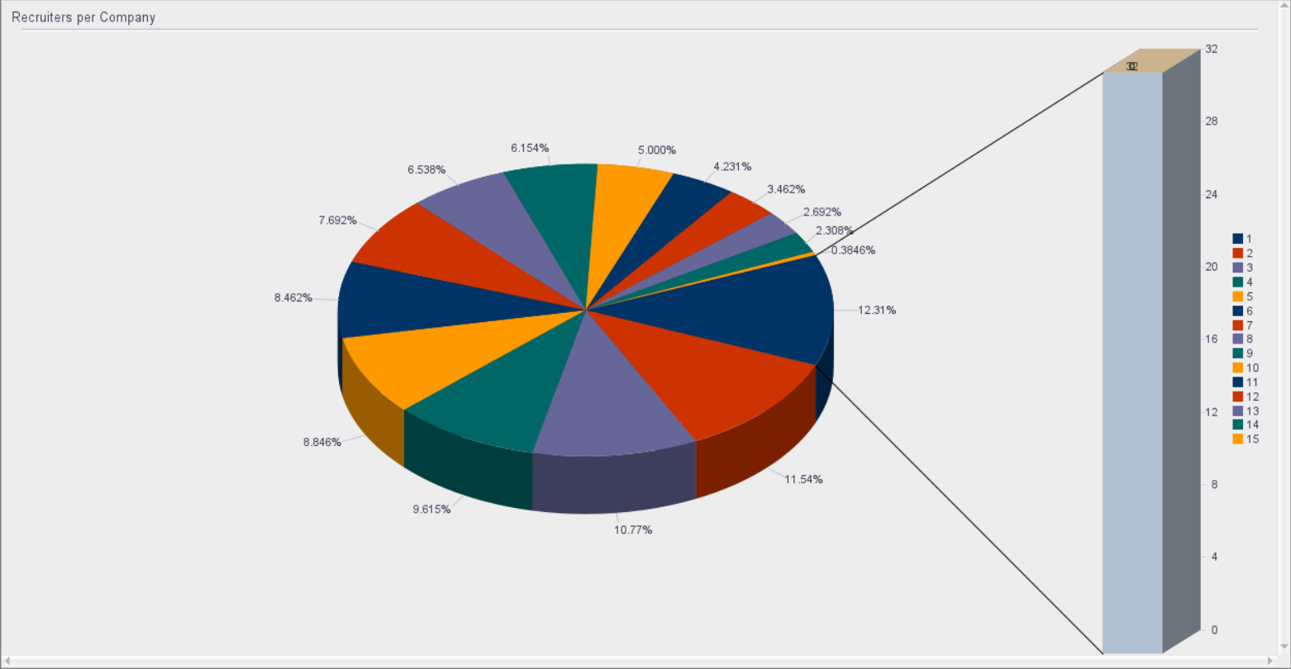

Slide 11
Thank You

